Slide 1
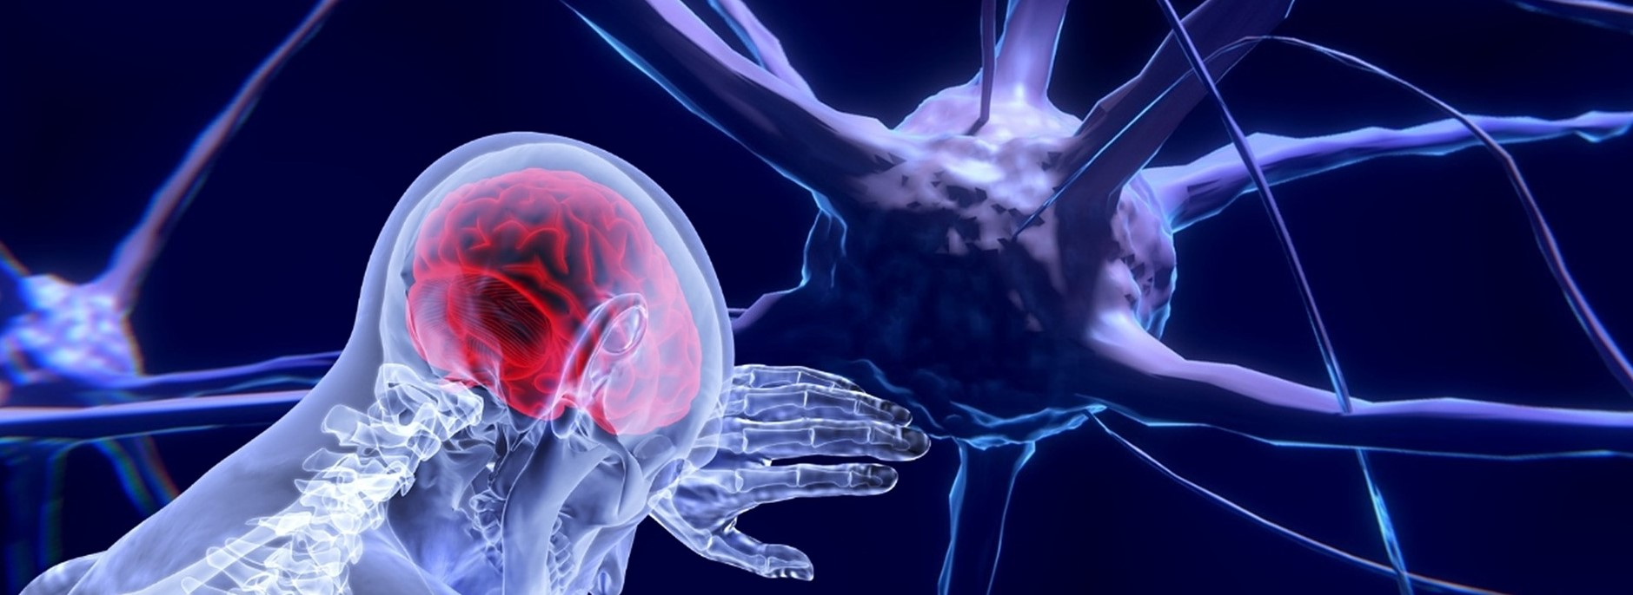
Introduction to Deep Learning
Stanley Dukor

Slide 2

What is Artificial Intelligence?

Slide 3
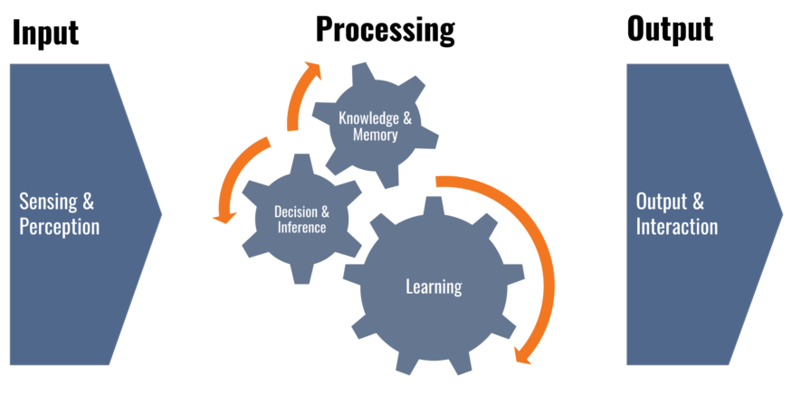
Artificial Intelligence
It is the development of computer systems able to perform tasks normally requiring human intelligence.

Slide 4
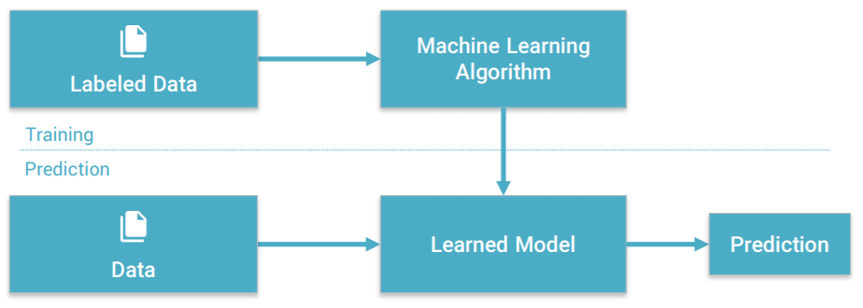
Machine Learning - Highlight
Machine Learning is a type of Artificial Intelligence that provides computers with the ability to learn without being explicitly programmed.

Slide 5
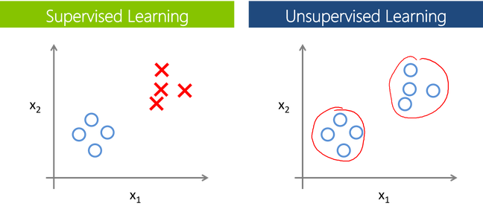
Machine Learning – Learning Approaches
Supervised Learning
Learning with a labeled training set
Example: email spam detector with training data of already labeled emails.
Unsupervised Learning
Discovering patterns in unlabeled data
Example: cluster bank customers based on age.
Notes:
Supervised is more accurate and trustworthy due to human verified labels, unlike unsupervised where the model learns and discovers patterns from the data by itself.
There is also reinforcement learning.

Slide 6
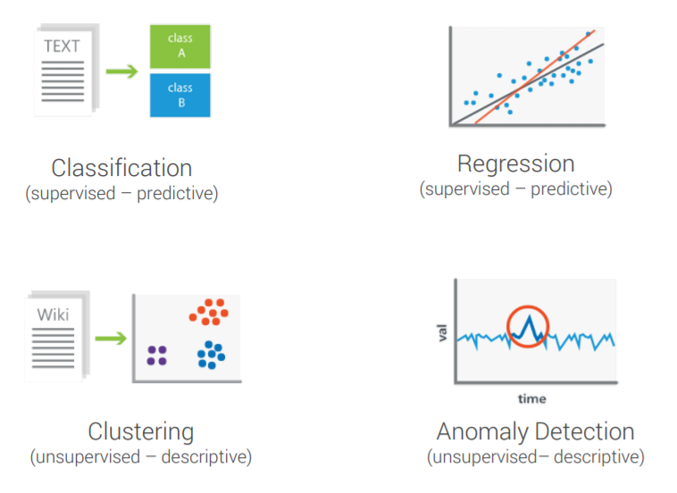
Machine Learning – Problem Types
Notes:
Supervised is more accurate and trustworthy due to human verified labels, unlike unsupervised where the model learns and discovers patterns from the data by itself.
There is also reinforcement learning.

Slide 7
Popular Machine Learning Algorithms
Linear Regression
Logistic Regression
Decision Trees
Naive Bayes
K-Nearest Neighbors
Support Vector Machines (SVM)
Bagging and Random Forest
Boosting (AdaBoost and XGBoost )
Apriori Algorithm
K-means clustering
Supervised Learning
Unsupervised Learning

Slide 8
What is Deep Learing?

Slide 9
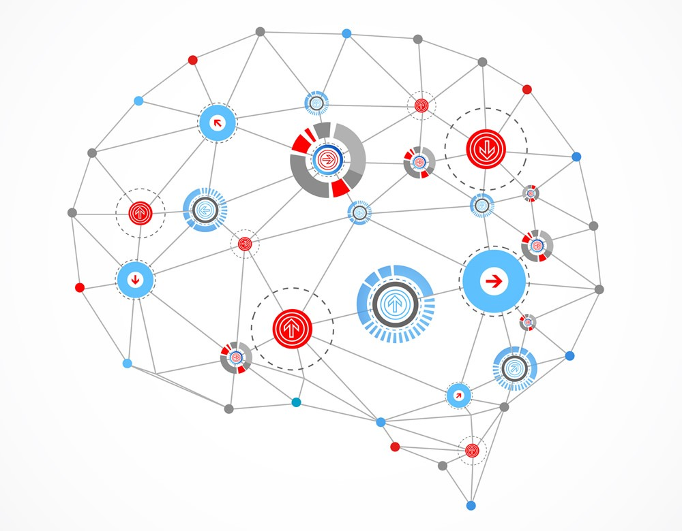
Deep Learning
An algorithm that derive meaning out of data by using a hierarchy of multiple layers that mimic the neural networks of our brain.
Deep learning algorithms are exceptional effective at learning patterns.
Providing a deep learning system with tons of information increases it’s ability to understand it, and respond in useful ways.

Slide 10
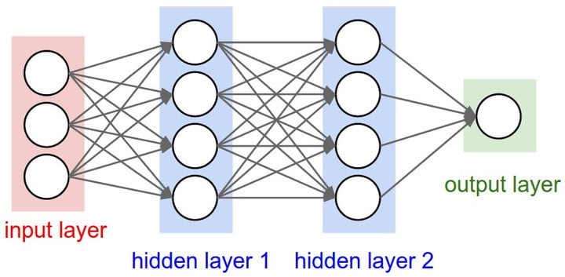
Deep Learning - Neural Networks
Artificial Neural Networks are brain-inspired systems which are intended to replicate the way we humans learn.
Neural networks consist of input and output layers, as well as (in most cases) a hidden layer consisting of units that transform the input into something that the output layer can use.
Each layer is represented as a series of neurons and progressively extracts higher and higher-level features of the input until the final layer essentially makes a decision about what the input shows.
The more layers the network has, the higher level features it will learn.
Basic Feedforward Neural Network.

Slide 11
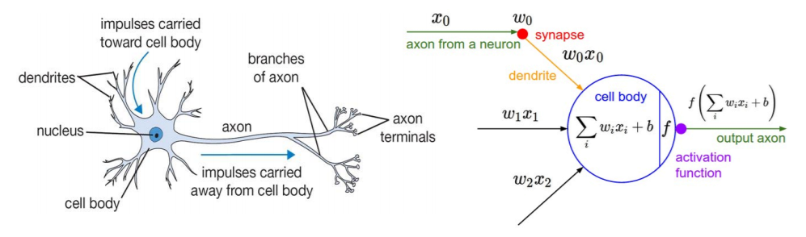
Deep Learning - The Neuron
An artificial neuron contains a nonlinear activation function and has several incoming and outgoing weighted connections.
Neurons are trained to filter and detect specific features or patterns (e.g. edge, nose) by receiving weighted input, transforming it with the activation function und passing it to the outgoing connections.

Slide 12
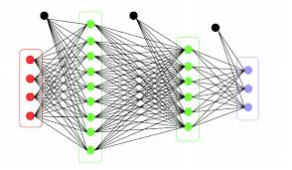
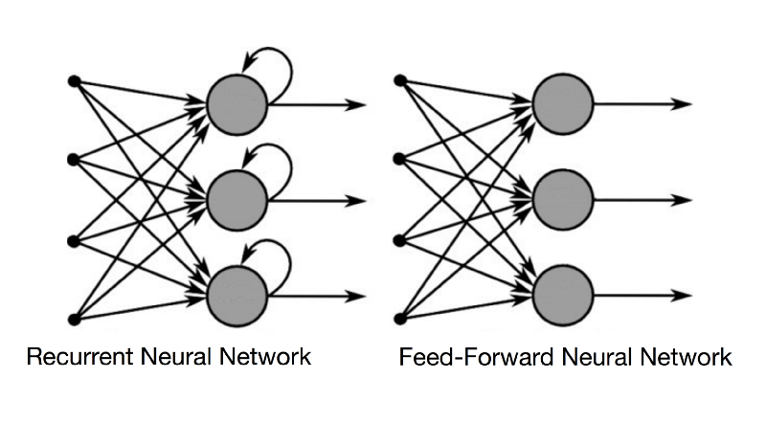
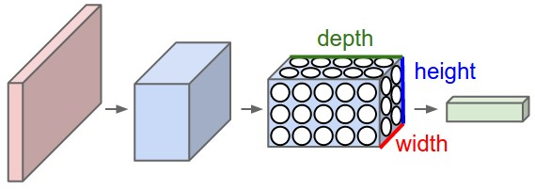

Deep Learning - Popular types of Neural Networks
Convolutional Neural Network (CNNs)
Recurrent Neural Network (RNNs)

Slide 13

A brief history
Of Deep Learning
13

Slide 14
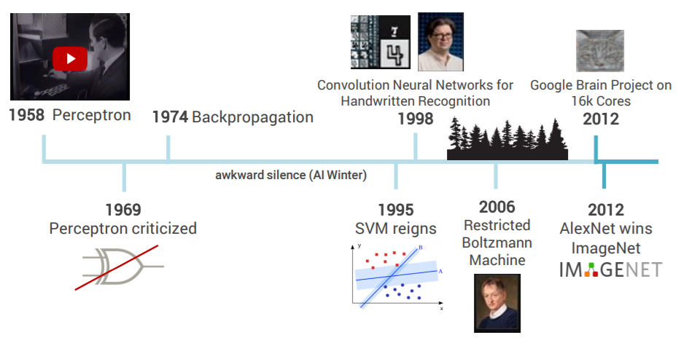
A long time ago …

Slide 15
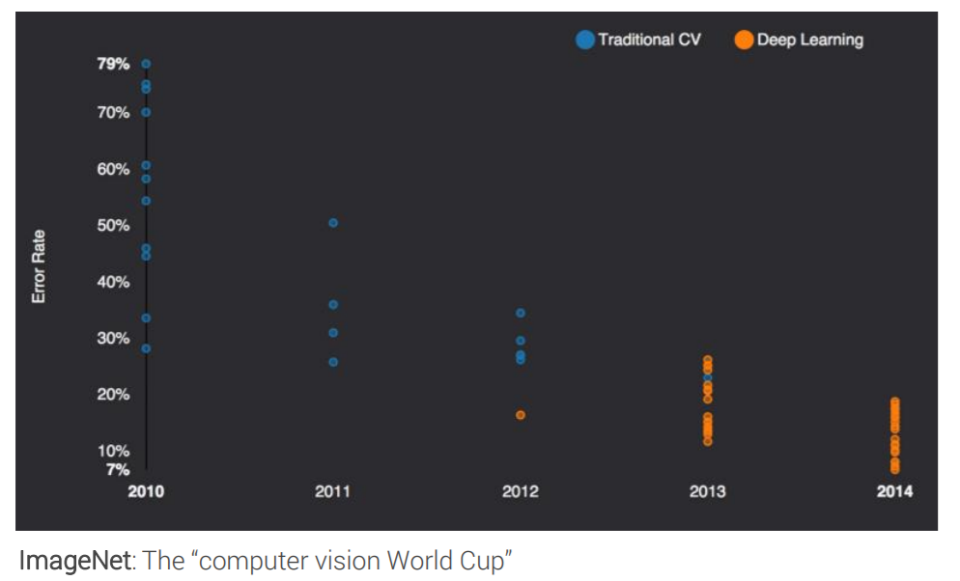
Deep Learning in Computer Vision

Slide 16
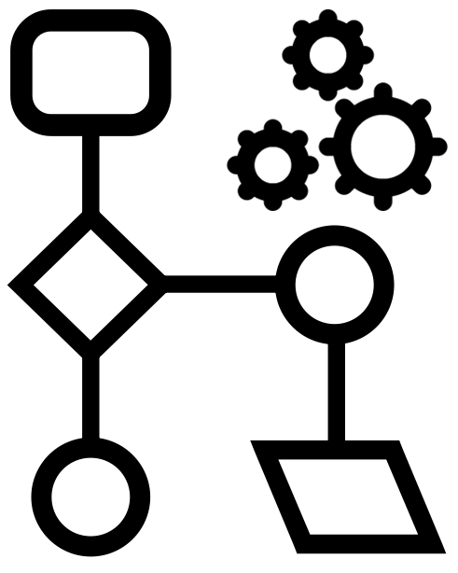
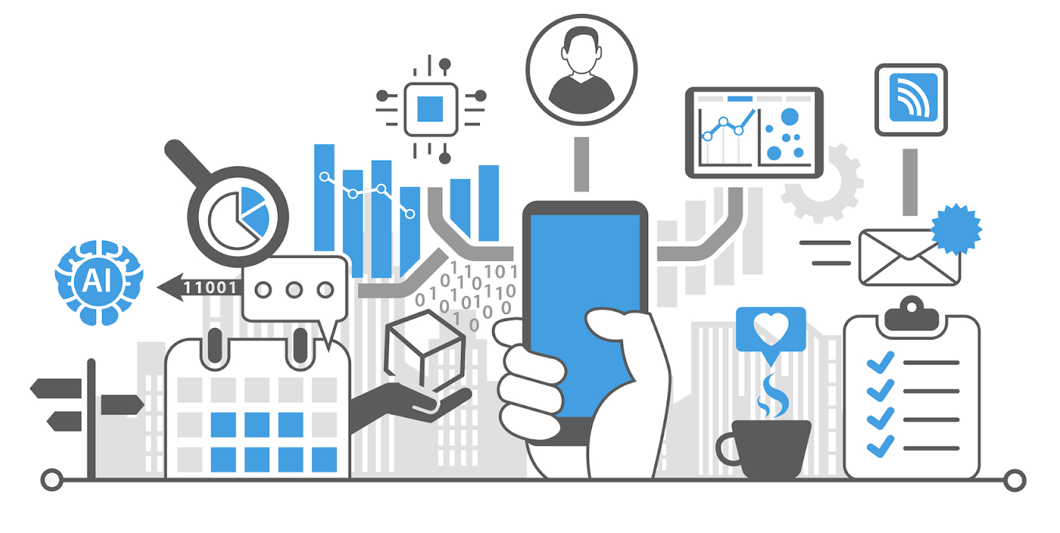
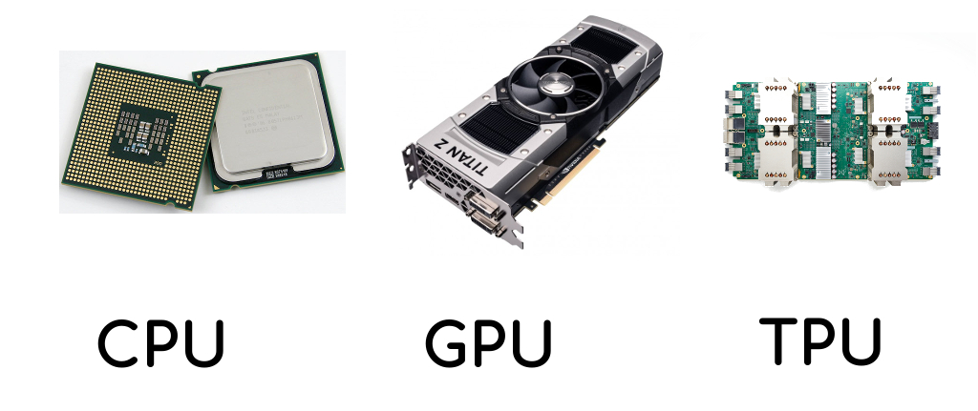
Why deep learning in impacting the world now?
Massive Data
Modern Algorithms
Computation Powerhouse

Slide 17
Deep Learning vs Machine Learning
Dee Learning
Require a massive amount of data to perform perfectly.
Performance does not rely on hand-crafted features and performs a hierarchical method of feature extraction (which means it learns features layer-wise).
Relies on high-end machines (GPUs are integral).
Needs a long time to train because of the presence of a huge number of parameters.
Machine Learning
Performs well even if the volume of the dataset is small.
Performance depends on hand-crafted features as inputs.
Can be performed on low-end machines. (CPU should do).
Needs much less time to train, from a few seconds to a couple of hours.
Notes:
deep learning lowers the task of creating new feature extractor for each and every problem.

Slide 18
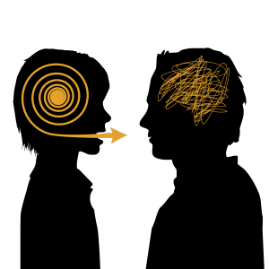


Applications of Deep Learning
Speech Recognition
Computer Vision
Natural Language Processing

Slide 19
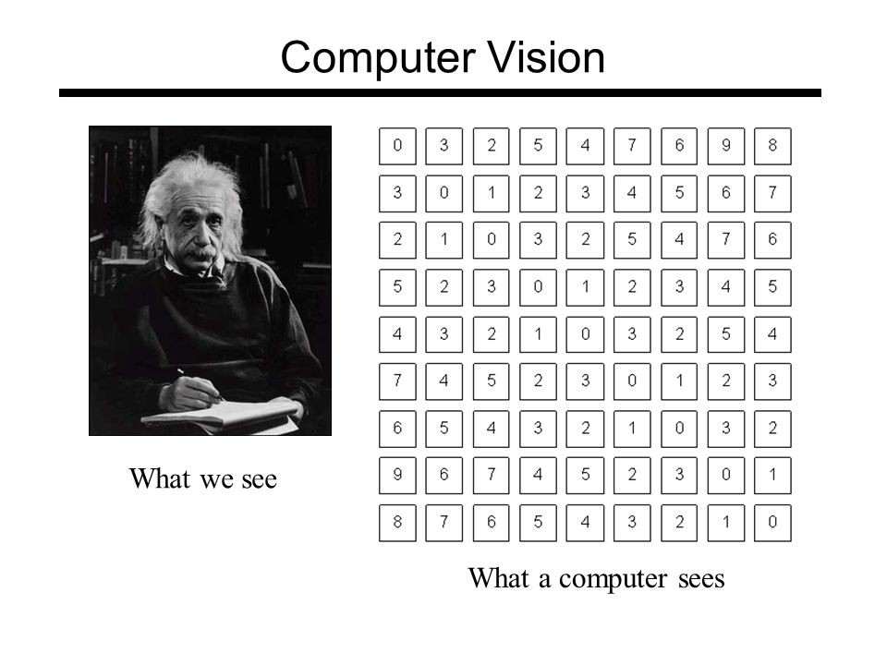
Deep Learning - Computer Vision
It is a field of computer science that works on enabling computers see, identify and process images.
Convolutional Neural Networks works well for most computer vision related problems.

Slide 20
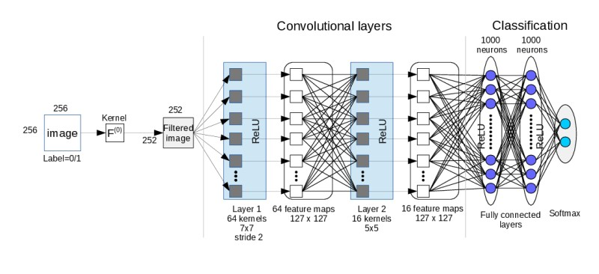

CNNs - How it works
Notes:
deep learning lowers the task of creating new feature extractor for each and every problem.

Slide 21


Deep Learning – Natural Language Processing
A form of artificial intelligence that focuses on analyzing the human language to draw insights, create adverts, text assistance and many more.
Common applications of NLP include;
Sentimental Analysis
Chatbots
Machine Translation
Text Classification
In most cases, RNNs works well.

Slide 22
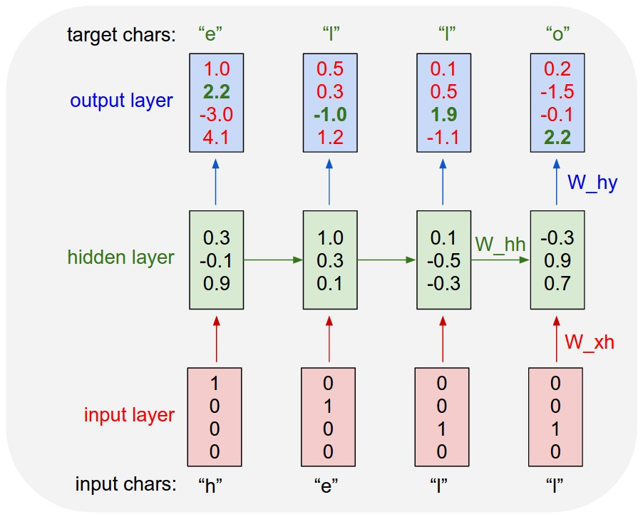
RNNs - How it works
Notes:
deep learning lowers the task of creating new feature extractor for each and every problem.

Slide 23




Everyday Applications
23

Slide 24



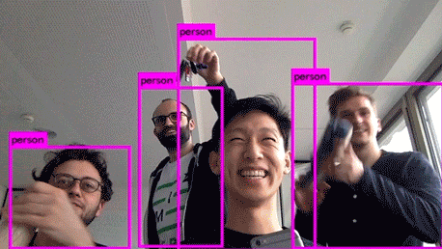
24

Slide 25

THANK YOU
Insert Image

